Slide 1

Understanding Sensor Networks
Explore the world of sensor networks. Learn about their components and functions. Discover how they monitor and transmit data wirelessly.

Slide 2

What is a Sensor Network?
1
Small Sensor Nodes
2
Wireless Communication
Placed near or within a monitored area.
Nodes collect and transmit data wirelessly.
3
Firefly Analogy
Nodes send signals to monitor the environment.

Slide 3
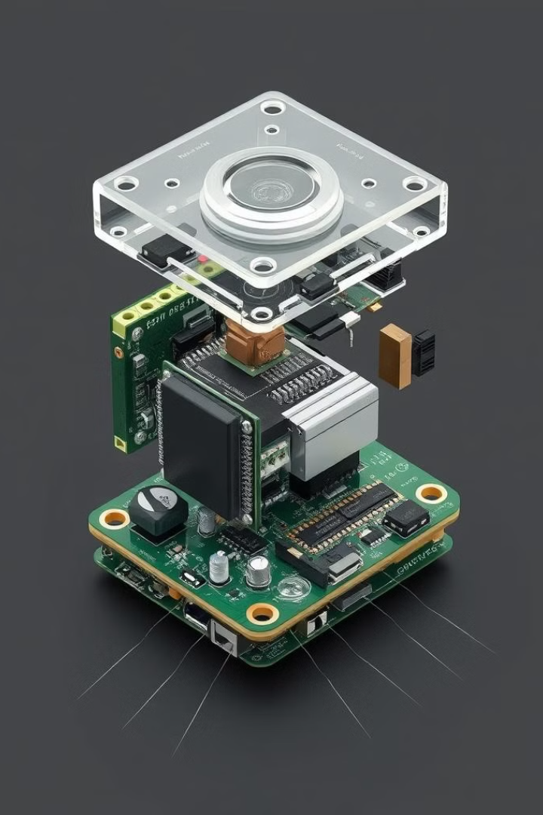




Anatomy of a Sensor Node
Sensors
Processor & Memory
Wireless Transceiver
Collect data from the environment.
Store and process collected data.
Communicate wirelessly with other nodes.
Power Supply
Provides energy to the sensor node.

Slide 4
Sensors: The Eyes and Ears
Passive Sensors
Active Sensors
Observe without affecting the environment.
Actively interact with the environment.
Example: Thermometer.
Example: Radar.

Slide 5

Microcontroller: The Brain
Data Processing
Alternatives
Processes data and controls components.
DSPs, FPGAs, and ASICs for specialized tasks.
Power Efficiency
Simple processing to save power.

Slide 6
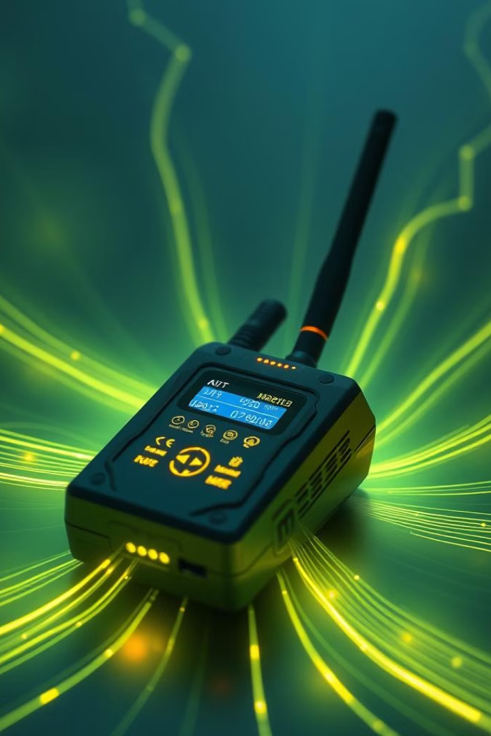



Transceivers: The Voice
Wireless Signals
Nodes communicate wirelessly.
ISM Bands
Uses free radio frequencies.
RF Signals
Common wireless transmission.

Slide 7



Memory: The Storage
2
Flash Memory
1
Data Storage
Application Needs
3

Slide 8

Power Source: The Life
1
Batteries
2
Energy Harvesting
Provide portable power for sensor nodes.
Captures energy from the environment.
3
Power Management
Optimizes energy usage for longer life.

Slide 9
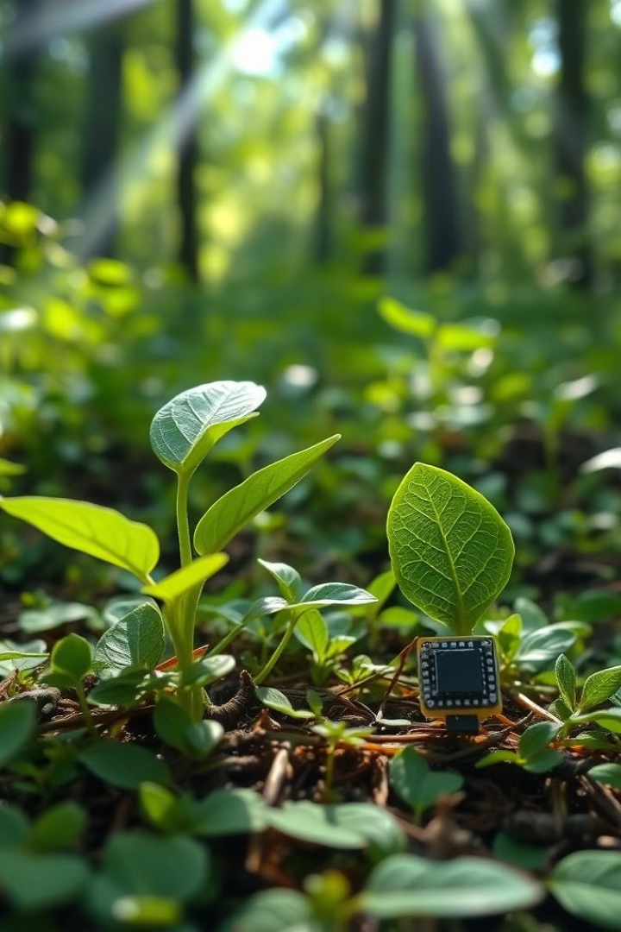
Power Management
1
Power Efficiency
Critical for long-lasting networks.
2
Dynamic Power Management
Turns off unused parts to save energy.
3
Dynamic Voltage Scaling
Adjusts power based on workload.

Slide 10

Thank You!
Thanks for joining this sensor network overview.
We hope it provided valuable insights.
Now you have the knowledge to go and sense the world.

